Slide 1
Air Quality Index Analysis
Presented By:
-Ruchi->Insights and presentation
-Sanskriti Srivastava -> PowerBI Dashboard
-Shivam Agrahari -> Data Cleaning And Transformation

Slide 2
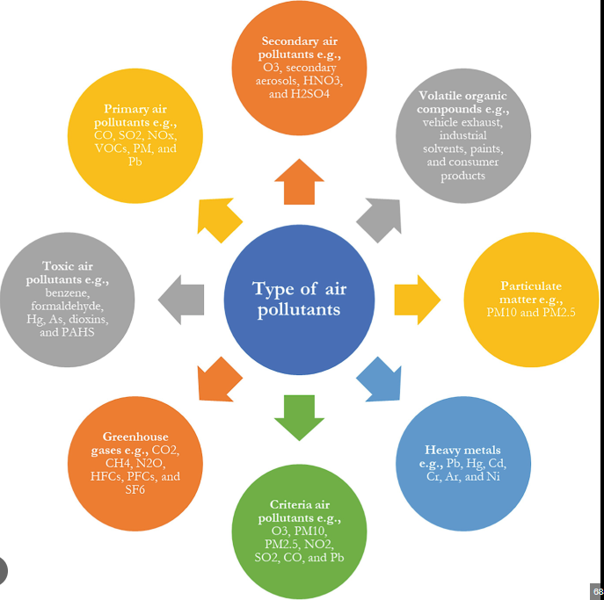
What is Air Quality Index?
The Air Quality Index (AQI) is a daily report that measures how clean or polluted the air is and the potential health effects of breathing it.
Why Should We Care?
Reduced air quality, leading to respiratory health issues.
Increased risk of cardiovascular diseases and stroke.
Worsened conditions for people with asthma and allergies.
Higher mortality rates due to pollution-related illnesses.
Decreased visibility, affecting road and air travel safety.

Slide 3
Air Quality Index (AQI): What It Measures
AQI Scale
The AQI scale ranges from 0 (Good) to 500 (Hazardous), indicating air quality levels.
Pollutants Measured
AQI measures key pollutants: PM2.5, PM10, Ozone, NO₂, SO₂, and CO, essential for assessing air quality.
Higher AQI = Worse Quality
A higher AQI signifies worse air quality, prompting the need for public awareness and action.

Slide 4
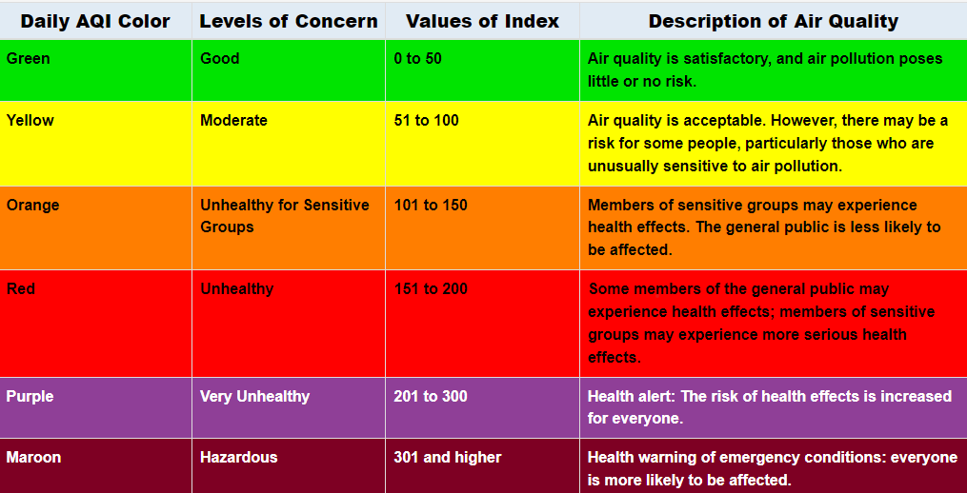
The Measures Of Air Quality Index

Slide 5



Data and Tools for Analysis
Utilizing advanced tools for comprehensive AQI evaluation
CSV Data Utilization
Employ CSV datasets of AQI across various regions and time frames for detailed study.
Python Libraries
Utilize Python's Pandas,Numpy for data manipulation and Matplotlib for effective visualization and SeaBorn
Interactive Dashboards
Leverage PowerBI for creating interactive dashboards that provide insightful analytics.

Slide 6
Key Performance Insight of AQI Analysis
Data Coverage: The dashboard covers data from 2015 to 2020, providing a 6-year trend analysis.
Overall AQI Trend: The average AQI has been decreasing over the years, from 196 in 2015 to 116 in 2020, indicating an overall improvement in air quality.
AQI Classification: The majority of AQI readings fall into the "Moderate" (45.75%) and "Satisfactory" (27.85%) categories.
-There are still significant portions in the "Poor" (9.42%), "Very Poor" (7.91%), and "Severe" (4.53%) categories, indicating room for improvement.
Seasonal Variation: Winter has the highest average AQI, followed by Autumn, Summer, and Monsoon.
-Monsoon season shows the lowest AQI, suggesting that rain helps improve air quality.
Seasonal Variation: Winter has the highest average AQI, followed by Autumn, Summer, and Monsoon.
-Monsoon season shows the lowest AQI, suggesting that rain helps improve air quality.
AQI Range: The minimum AQI recorded is 13.00, while the maximum is 2.05K (2,050).
-The overall average AQI is 166.46, which falls in the "Unhealthy" category.

Slide 7
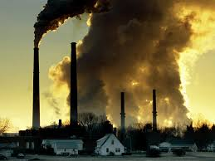
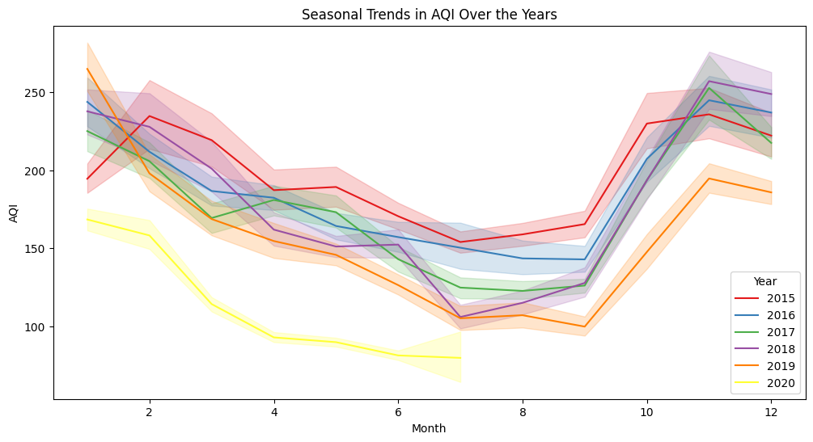
AQI Trends: Seasonal Variations over month every year

Slide 8
Insights from Previous Chart of Seasonal Variation
Seasonal Patterns: The graph clearly shows distinct seasonal patterns in AQI. Levels tend to be higher during the winter months (October to February) and lower during the summer months (May to August). This is likely due to factors like increased burning of biomass for heating during winter and reduced atmospheric dispersion of pollutants during colder months.
Year-to-Year Variability: While the overall seasonal patterns are consistent, there is considerable year-to-year variation in AQI levels. Some years exhibit significantly higher AQI values compared to others, suggesting that factors like weather conditions, emissions sources, and pollution control measures can influence AQI fluctuations.
Peak AQI Periods: The highest AQI levels typically occur in the late autumn and early winter months (November and December). This coincides with increased pollution from various sources, including Diwali celebrations, burning of stubble, and increased domestic heating.
Improvement in Certain Years: In some years, there appears to be a slight improvement in AQI levels, particularly during the summer months. This could be attributed to factors like stricter pollution control measures, favorable weather conditions, or increased awareness about air pollution and its health impacts.

Slide 9
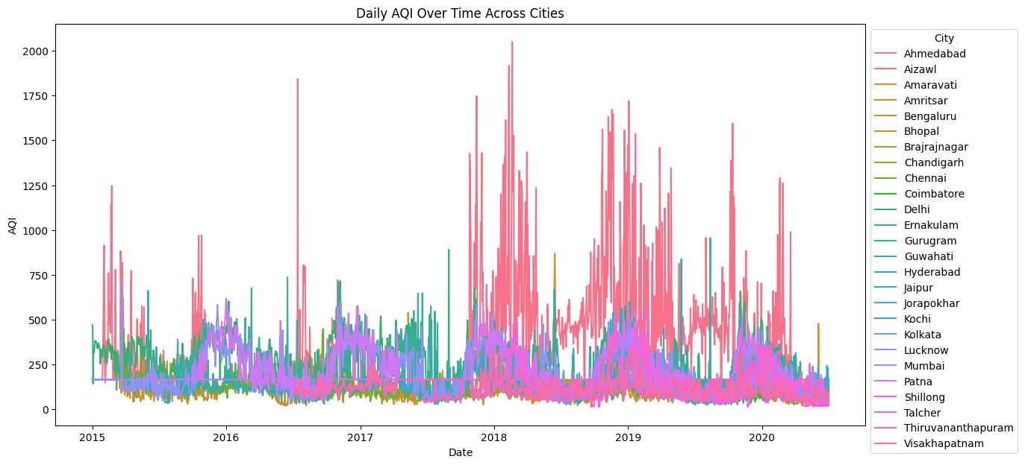
Pollution Spikes in Cities

Slide 10

Analysis of previous graph
**Ahmedabad** shows the highest AQI spikes, exceeding 2000, indicating extreme pollution levels.
Other cities display moderate AQI trends, generally fluctuating between 250 and 500.
Pollution levels seem to increase periodically, particularly during 2017-2019.
The AQI in most cities remains above 100, suggesting unhealthy air quality across regions.
Few cities like Kochi, Bengaluru, and Thiruvananthapuram exhibit lower and more stable AQI levels.

Slide 11
Potential cause of increasing pollution over different season
Winter (November to February):
Autumn (September to November):
Summer (March to June):
Monsoon (July to September):
Pollution levels generally peak during winter, particularly in cities like Delhi and Ahmedabad. The data shows higher AQI values during this period.
Reason:
Colder temperatures and stagnant air lead to the formation of temperature inversions, trapping pollutants close to the ground. Additionally, increased burning of biomass (heating, crop burning) worsens air quality.
AQI values are also elevated during this season, with spikes observed in regions impacted by post-harvest crop burning (e.g., Punjab, Haryana).
Reason:
Crop residue burning contributes heavily to particulate matter (PM2.5 and PM10), affecting cities downwind.
Pollution is typically lower compared to winter but still moderate in urban areas with high traffic.
Reason:
Strong winds and higher temperatures improve the dispersion of pollutants, lowering AQI.
The lowest pollution levels are seen during the monsoon season due to rainfall.
Reason:
Rain acts as a natural cleanser, washing away airborne pollutants and improving air quality.

Slide 12
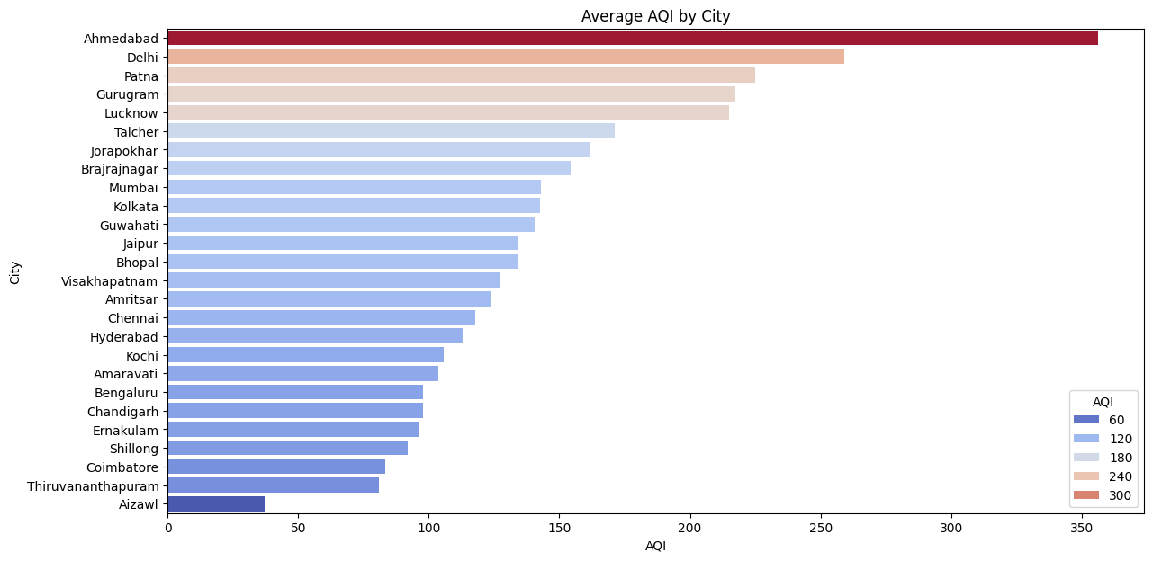
Comparison of Aqi Among the cities
Ahmedabad is most polluted city as AQI is more than 300

Slide 13
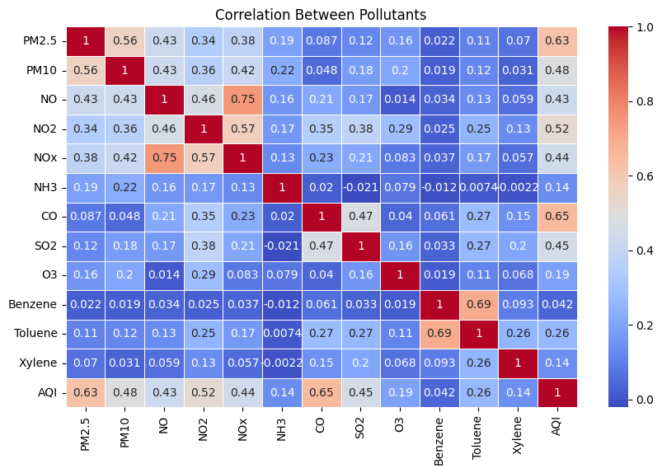
Correlation between all the pollutants
PM2.5 and AQI:
High correlation (0.63): PM2.5 shows the strongest correlation with AQI, suggesting it is a major contributor to poor air quality and should be closely monitored.
CO and AQI:
Second highest correlation (0.65): CO (Carbon Monoxide) also has a strong positive correlation with AQI, indicating its significant role in determining air quality levels.
NO2 and AQI:
Moderate correlation (0.52): NO2 (Nitrogen Dioxide) is moderately correlated with AQI, implying its impact on air quality, likely from vehicle emissions and industrial activity.
SO2 and AQI:
Moderate correlation (0.45): SO2 (Sulfur Dioxide) contributes moderately to AQI, linked to burning fossil fuels in industries and power plants.
Low correlation pollutants:
NH3, Benzene, and Xylene show very low correlations with AQI, indicating these pollutants have less direct influence on overall air quality levels compared to others like PM2.5, CO, and NO2.

Slide 14
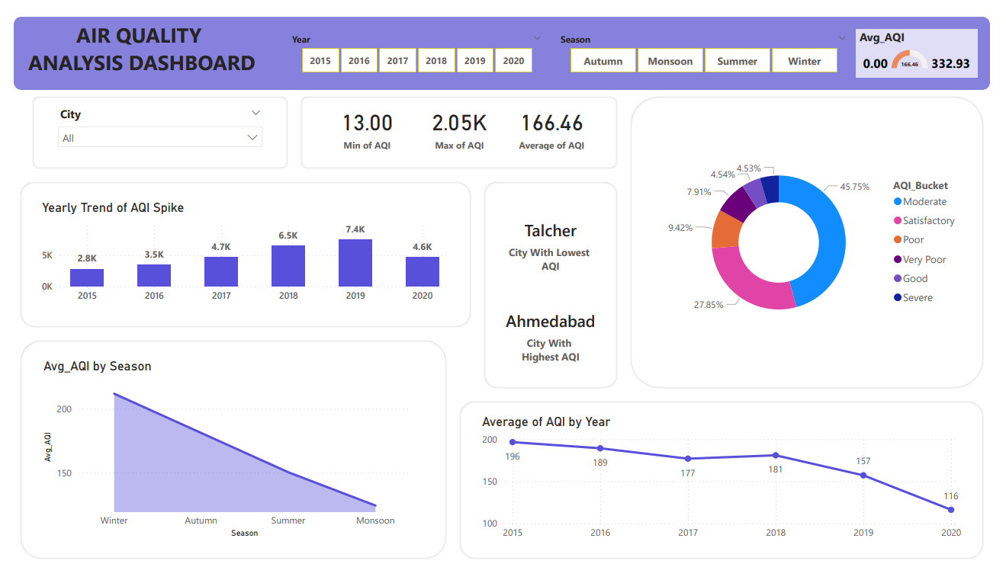
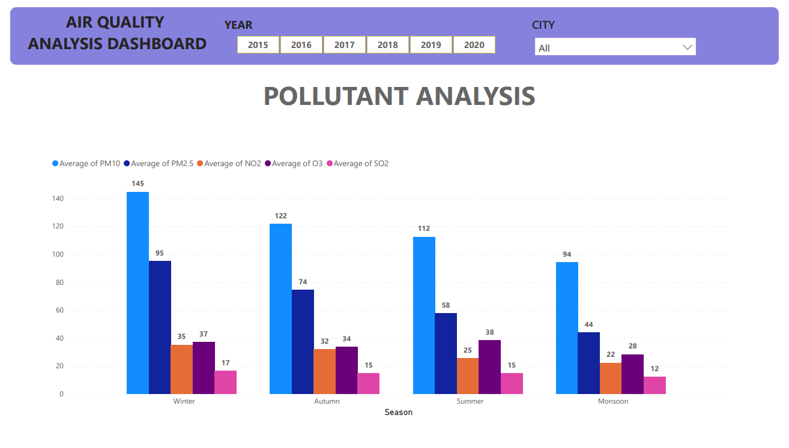
An Overview to our AQI Index Analyzer dashboard using Power BI

Slide 15

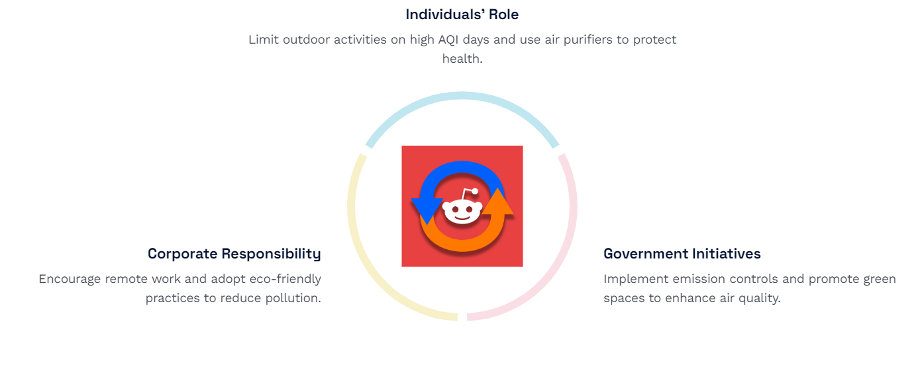

Slide 16
Thank you

